Slide 1

Brazil GDP Prediction: Machine Learning for Economic Intelligence
Analysis using 65 years of World Bank data to predict Brazil's economic trajectory for strategic planning and long-term investment decisions.

Slide 2

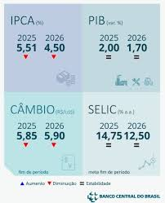
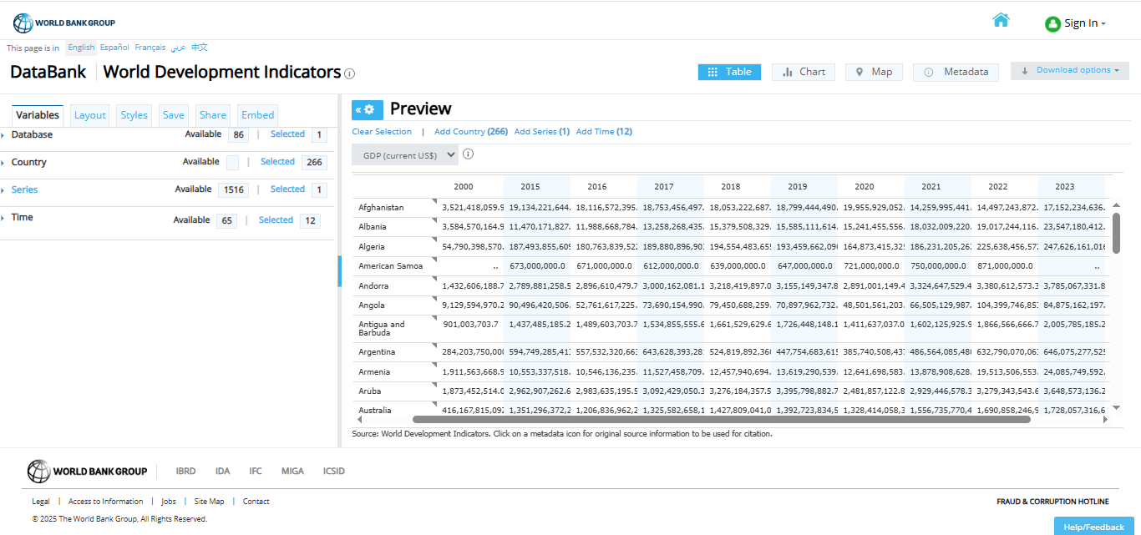
Project Overview
Business Challenge
Solution
Comprehensive World Bank dataset (65 years).
Economic uncertainty
Machine learning models.
Need for data-driven GDP forecasting.
Insights that lead to other approaches
Multiple economic indicators must be considered.
Long-term investment decisions depend on economic outlook.
https://databank.worldbank.org/reports.aspx?source=2&series=NY.GDP.MKTP.CD

Slide 3





Project Objectives
Develop Accurate Models
Process & Clean Data
Compare ML Algorithms
Forecast Brazil's GDP for the next 10 years using machine learning techniques and comprehensive economic indicators.
Standardize 65 years of World Bank economic data, removing incomplete series and imputing missing values with K-NN.
Evaluate multiple machine learning algorithms to identify the most effective for GDP prediction, including Neural Networks and traditional models.
Identify Key Indicators
Provide Actionable Insights
Determine the most influential economic indicators affecting Brazil's GDP through rigorous correlation analysis.
Deliver reliable 10-year economic forecasts and strategic recommendations to support investment and policy decisions.

Slide 4
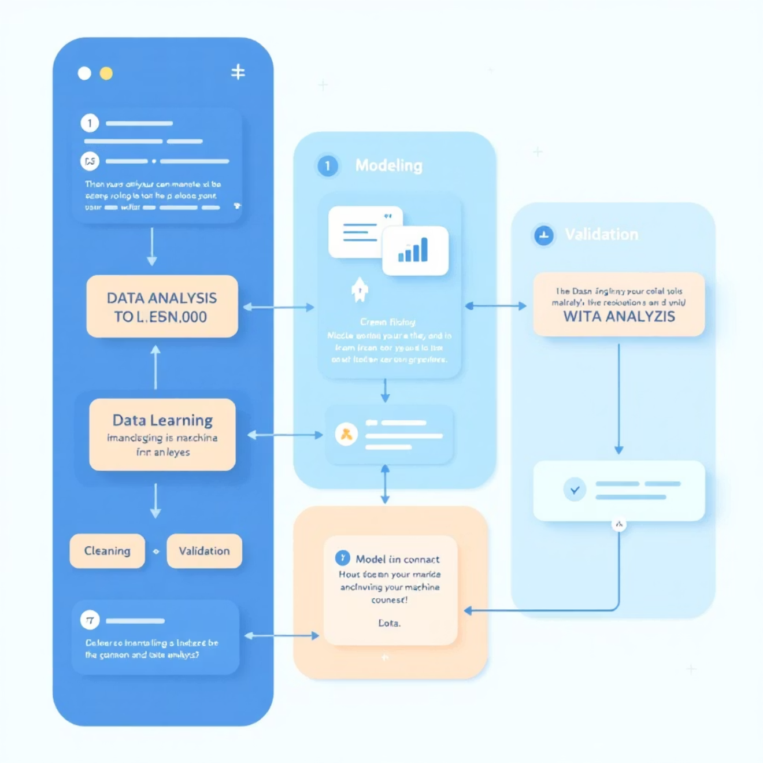
Project Scope
Key Focus Areas
65
Absolute GDP forecasting (USD).
1,521
GDP growth rate predictions (%).
Historical Data
Economic indicator correlation analysis.
Years of historical World Bank data (1960-2024) for comprehensive analysis.
Economic Variables
Metrics for performance comparison.
Data quality optimization and strategic recommendation development.
Cleaned and refined economic variables used in the predictive models turns into:
45.8%
10
696
Economic Variables
Forecast Horizon
Years for which GDP is predicted (2025-2035)

Slide 5
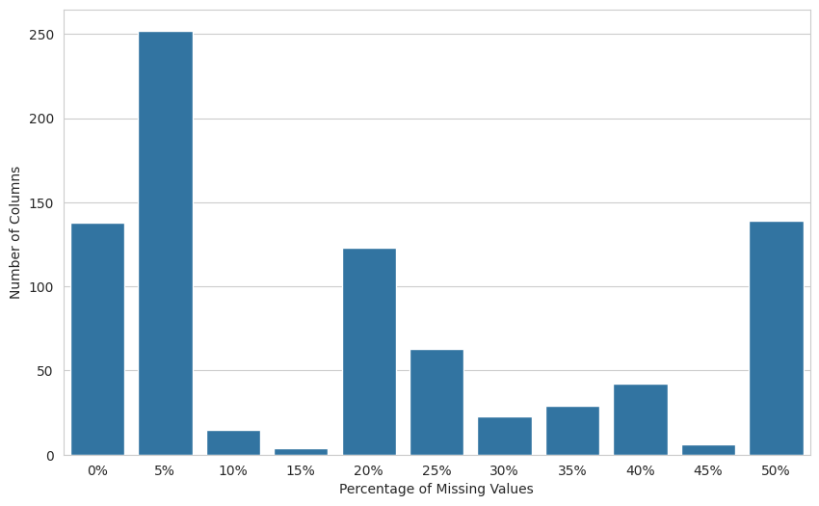
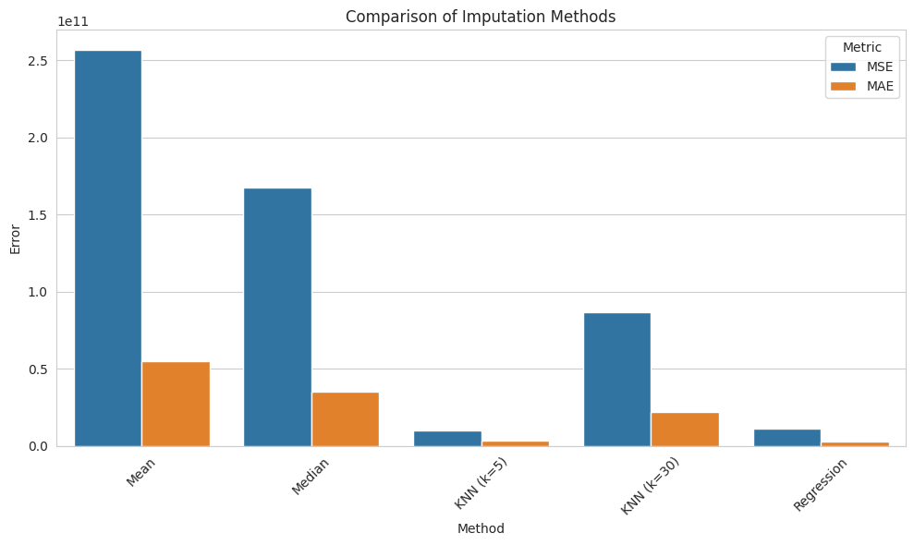
Methodology
Data Processing
Sourcing from World Bank DataBank, cleaning incomplete series (>50% missing), imputing with K-NN (5 neighbors).
Quality Assurance
Rigorous testing with 100-200 masked values to validate imputation methods, ensuring model reliability and accuracy for robust forecasts.
Modeling Approach
Feature engineering for multivariate time series, MinMax normalization, temporal train-test split, and evaluation with RMSE, MAE, R² metrics.

Slide 6


Types of Analysis and Algorithms Applied
Exploratory Analysis
Comparative Analysis
Assessed data quality, identified missing value patterns, and performed correlation analysis between key economic indicators to understand underlying relationships.
Systematically evaluated algorithm performance across multiple machine learning approaches, five for each variable.
Ensuring statistical validation using various error metrics
Model Selection Strategy
Classification Algorithms
Systematic comparison of 9 model variations.
K-NN Imputation: Employed for robust handling of missing data points across the extensive dataset.
Evaluated using R-squared, RMSE, and MAE metrics.
Identified the best performing algorithm
Ensemble Approach: Used for comprehensive multiple model comparison

Slide 7

Algorithms Applied
Predictive Analysis for multivariate variables
4 models for Absolute values from GDP (US$)
Utilized advanced time series forecasting with neural networks and regression models to generate 10-year GDP prediction horizon.
Neural Network Models
4 models for values from GDP growth (%)
Simple RNN: Recurrent Neural Networks for sequential pattern recognition.
LSTM: Long Short-Term Memory networks for capturing long-term dependencies.
First approach - implementation with 50 units, sequence length 20
Second approach - More conservative with 32→16 units, dropout layers, smaller batches
Architecture: Multiple layers with dropout regularization to prevent overfitting and enhance generalization.
First approach - implementation with 50 units, sequence length 20
Second approach - 16 units with dropout, more conservative

Slide 8
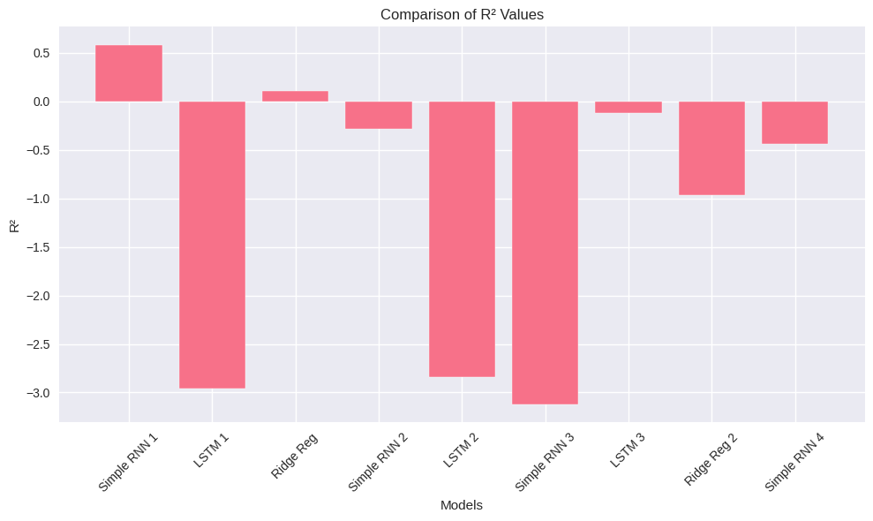
Model Performance Results
GDP Metrics
Best Model: Simple RNN for Absolute GDP achieved
the highest R² score.
Not effective handling of large-scale economic data.
Not captures long-term economic trends accurately.
The predictions deteriorate as the models run
1º Try
Absolute GDP Models:
Simple RNN 1: R² = 0.3894
LSTM 1: R² = -1.6320
Simple RNN 2: R² = 0.0696
LSTM 2: R² = -0.3660
Growth Models:
Simple RNN 3: R² = -0.5084
LSTM 3: R² = -1.0897
Simple RNN 4: R² = -6.8943
2º Try
Absolute GDP Models:
Simple RNN 1: R² = 0.5890
LSTM 1: R² = -8.8965
Simple RNN 2: R² = -26.5017
LSTM 2: R² = -10.9181
Growth Models:
Simple RNN 3: R² = -3.0921
LSTM 3: R² = -0.2430
Simple RNN 4: R² = -2.0159
3º Try
Absolute GDP Models:
Simple RNN 1: R² = 0.4053
LSTM 1: R² = -0.5917
Simple RNN 2: R² = -27.1107
LSTM 2: R² = -2.5392
Growth Models:
Simple RNN 3: R² = -4.4997
LSTM 3: R² = -0.2099
Simple RNN 4: R² = -0.6975
4º Try
Absolute GDP Models:
Simple RNN 1: R² = 0.2688
LSTM 1: R² = -0.7249
Simple RNN 2: R² = -32.3929
LSTM 2: R² = -2.9632
Growth Models:
Simple RNN 3: R² = -4.4284
LSTM 3: R² = -1.1302
Simple RNN 4: R² = -0.8793

Slide 9
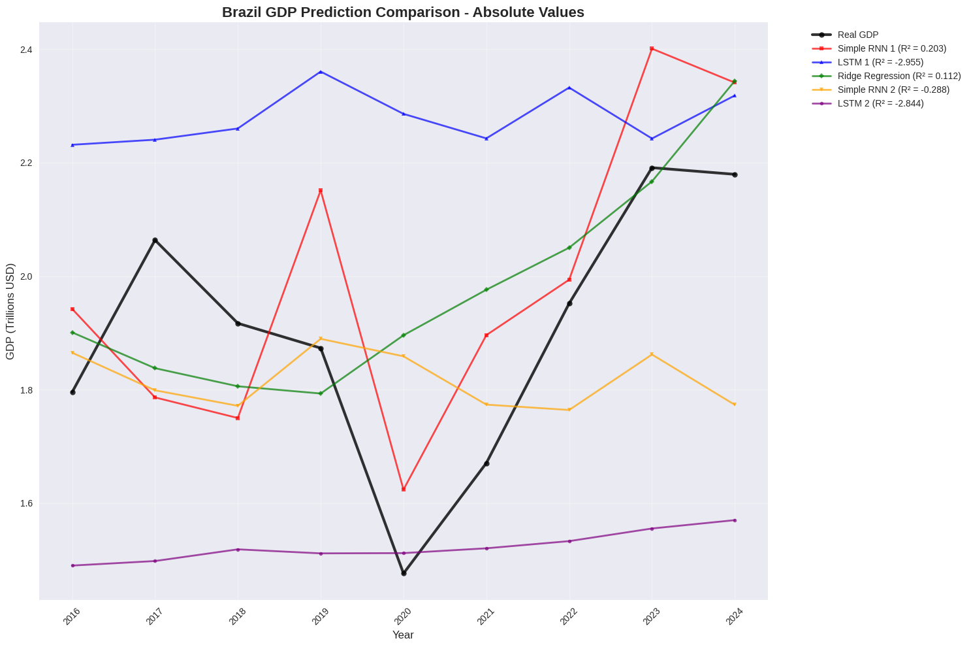
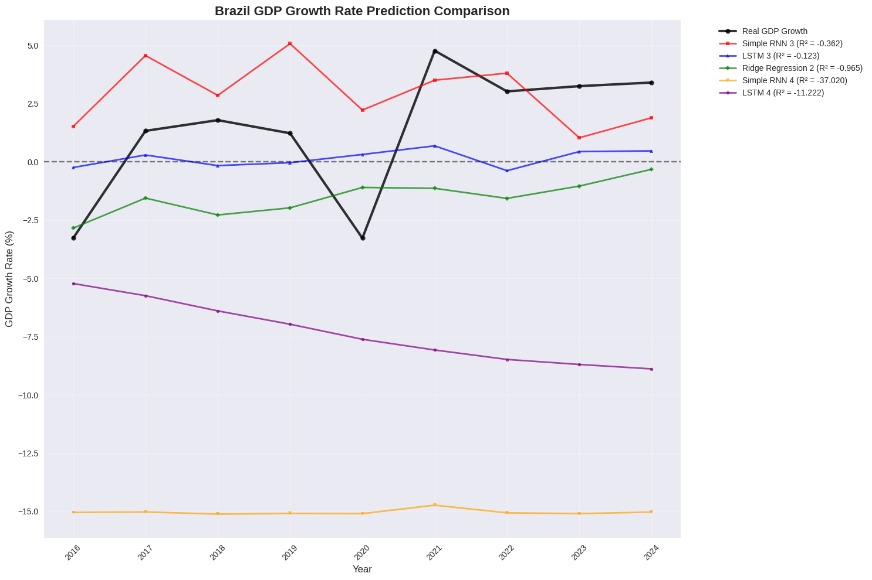
Accuracy of the executed models

Slide 10
Key Findings
Model Insights
Challenges Identified
Limited time series length (65 years) impacted model training. High dimensionality necessitated careful feature selection. Economic volatility in Brazil also posed challenges to prediction accuracy, requiring robust models.
Growth rate predictions were more stable and reliable than absolute values. Feature correlation analysis successfully identified key economic drivers, providing deeper understanding for the next steps
Data Quality Impact
High-quality data preprocessing was critical. Removing 167 variables with >50% missing data significantly improved model reliability and accuracy.
Only have 65 total data points, could not use sequential length openly, after creating sequences it left just 45 sequences, and after split only 9 test.
Probably this was not the better case for this kind of data.
Curse of dimensionality for small dataset
Top 10: strongest and weakest GDP correlation
GDP (US$)
GDP (%)
1 : 0.9999
2 : 0.9998
3 : 0.9993
4 : 0.9992
5 : 0.9980
6 : 0.9969
7 : 0.9964
8 : 0.9946
9 : 0.9945
10: 0.9920
1 : 0.0270
2 : 0.0230
3 : 0.0130
4 : 0.0116
5 : 0.0073
6 : 0.0003
7 : Nan
1 : 0.9798
2 : 0.9659
3 : 0.9425
4 : 0.8387
5 : 0.8315
6 : 0.8248
7 : 0.7747
8 : 0.7543
9 : 0.6980
10 : 0.6770
1 : 0.0109
2 : 0.0101
3 : 0.0101
4 : 0.0069
5 : 0.0065
6 : 0.0027
7 : Nan

Slide 11

Thank you!
¡Gracias!

